Slide 1
Paythor API Payment System

Slide 2
Project Purpose
Technologies Used
Allows users to register and log in
Provides secure authentication with OTP
Can generate payment links and display their details
A web application integrated with the Paythor API
HTML, CSS, JavaScript
Paythor REST API
Session management with localStorage

Slide 3
Main Features
Registration: Register with user and merchant information
Login: Login with email and password, then OTP verification
Session Management: Manage session with token (localStorage)
Create Payment: Generate a payment link with interactive product/cart management
Payment Details: View details of the generated payment link

Slide 4
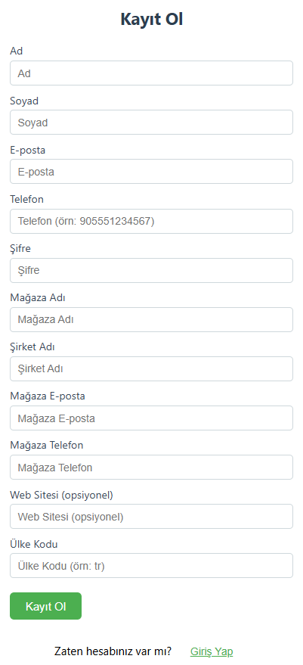
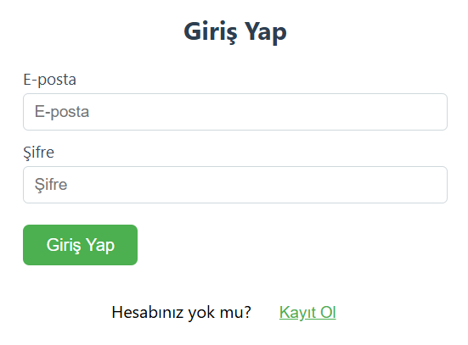
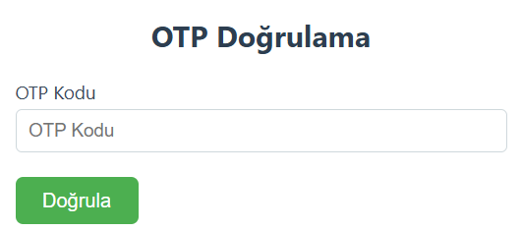
Flow
1. User registers.
2. Logs in and verifies with OTP code.
3. After successful login, accesses payment panel
4. Adds/removes products, enters shipping & invoice info
5. Creates payment link and views payment details

Slide 5
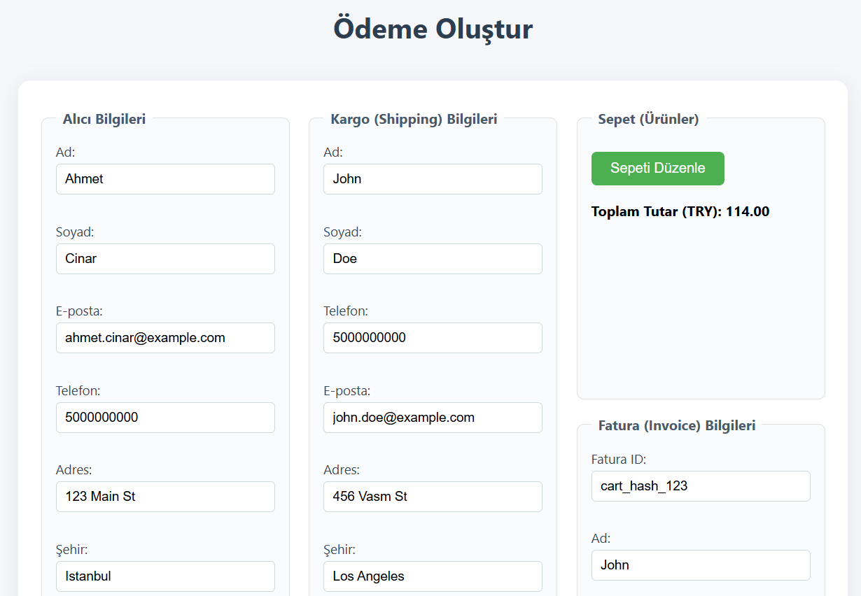

Slide 6
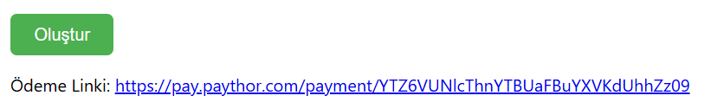
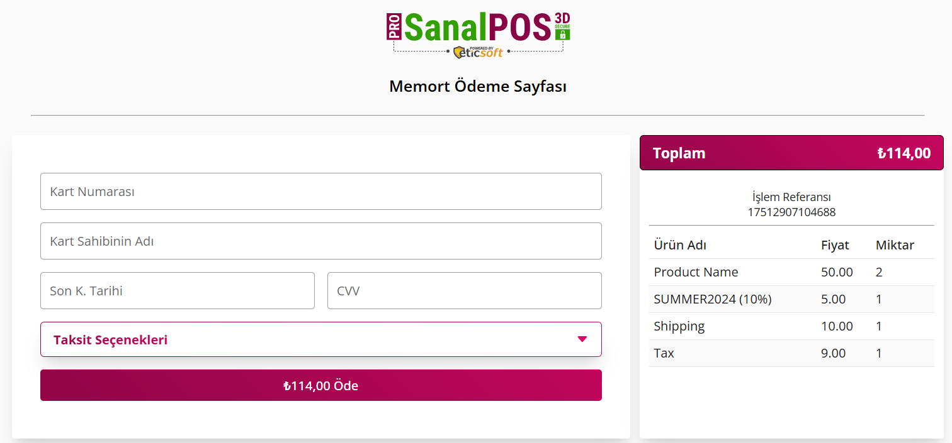

Slide 7
Conclusion
Fast and secure payment integration
User-friendly and interactive interface

